Slide 1



Problem Statement : TO PROTECT THE WORLD FROM COVID -19
Details: Instruction step by step with audio & text to detect covid +ve or –ve , scan temperature , hand for the detect germ % and sanitize hand , measuring oxygen level & surrounding area.
Area of innovation : Health Care & Artificial Innovation
Team Name– DBP Covi Clean & Care
Team Leader Name - Prakriti Banik
Institute – Brainwave University

Slide 2
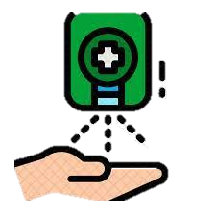

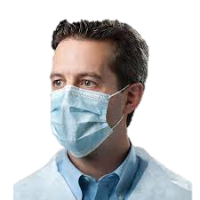
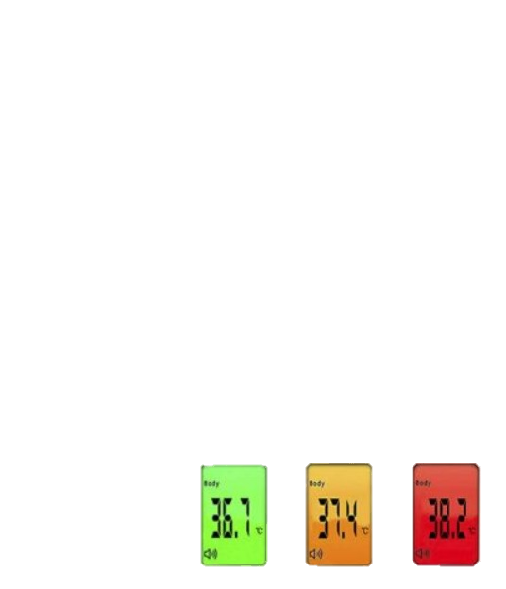



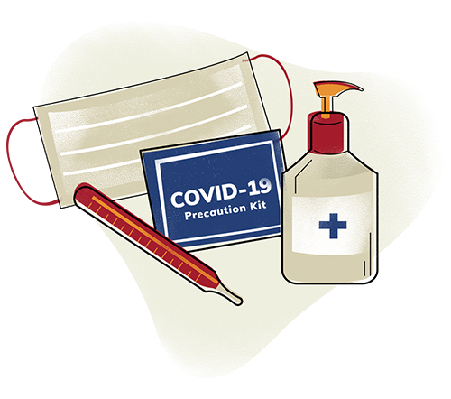
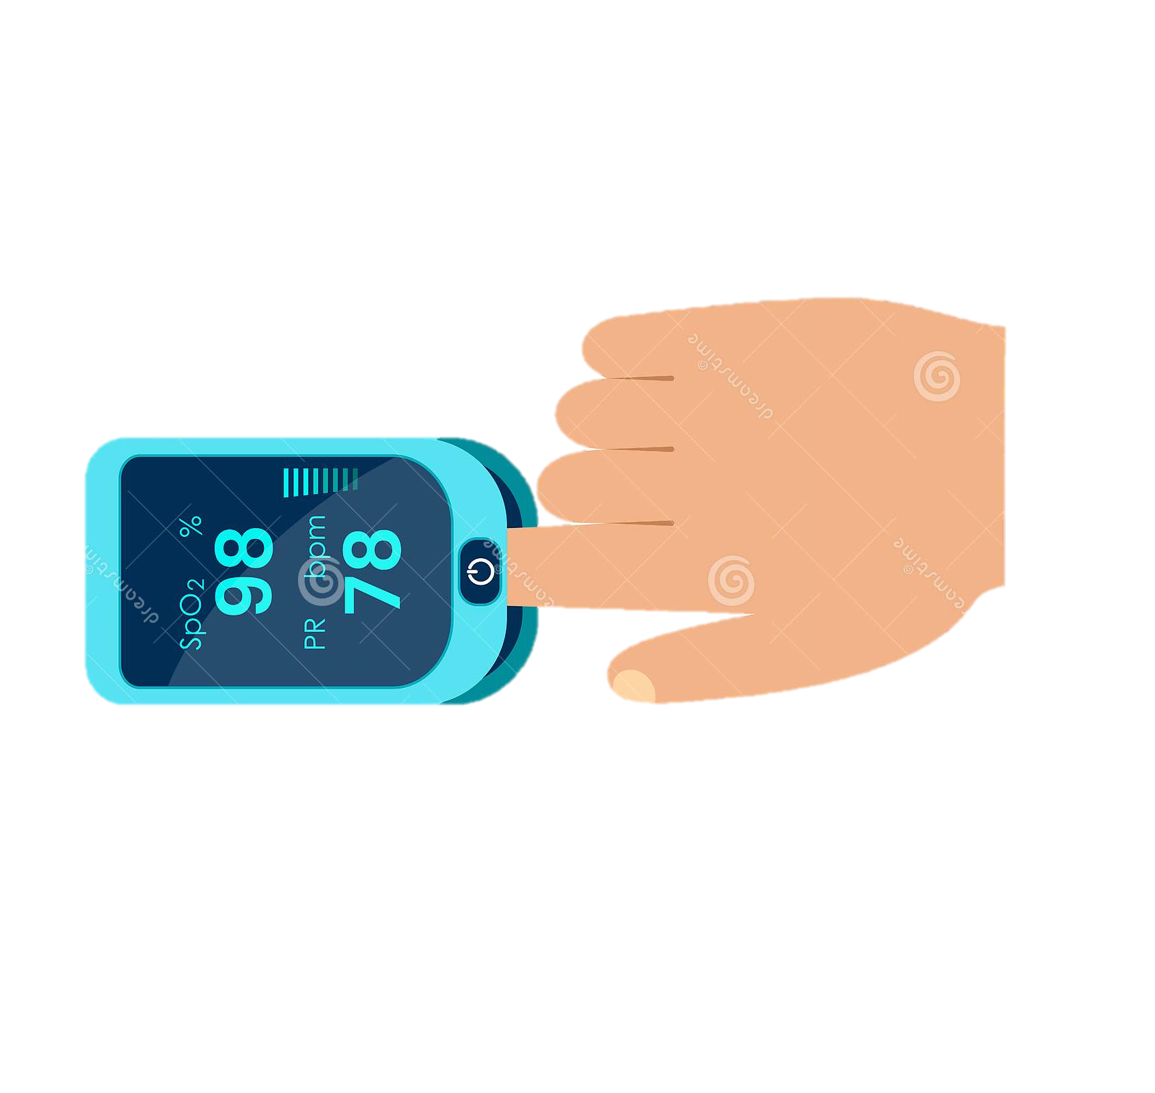


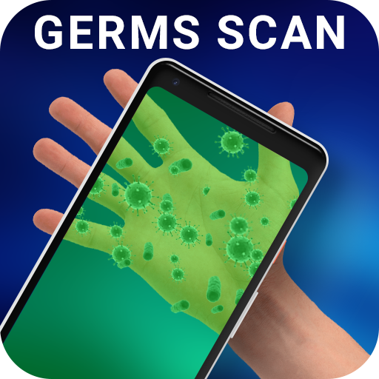
Idea Details
Voice Kit :
Every instruction give to user step by step in audio .
Mask mode :
When the mask mode is ON then camera detect the person who have ware mask or not. If not then it give warning.
Auto Hand Sanitizer :
After scanning temperature people sanitize their hand and again scan their hand to check if germs parentage is >= 60% then again sanitize.
Covid kit :
Only The person whose temperature is high ,for them the covid kit is out from the machine for checking the person is covid +ve or –ve.
Temperature scanner :
It Scan the body temperature instantly and display the result in colorful display.
Auto Air Sanitizer :
It will sanitize the surrounding area continuously .
Oximeter :
It is measure the oxygen percentage in blood.
Tank 1 and tank 2 - contain liquid and display the liquid validity of both.
Germs Detector :
It scan the hands for detect the germs percentages and display the result.

Slide 3



